Slide 1

Department of BES-II
BASIC ELECTRICAL & ELCTRONIC CIRCUITS (BEEC)
COURSE CODE : 23EC1203
Topic:
Mesh and nodal analysis &
numerical Examples
Session – No.3

Slide 2



AIM OF THE SESSION
To familiarize students with the concept of Mesh and Nodal Analysis and analyzing electrical circuits using Mesh and Nodal Analysis.
INSTRUCTIONAL OBJECTIVES
This Session is designed to:
Describe the steps in Mesh Analysis and Demonstrate to solve some Numerical examples with Mesh Analysis.
Describe the steps in Nodal Analysis and Demonstrate to solve some Numerical examples with Nodal Analysis.
LEARNING OUTCOMES
At the end of this session, you should be able to:
Solve electric circuits by applying the Mesh Analysis
Solve electric circuits by applying the Nodal Analysis

Slide 3
Mesh Analysis
A Mesh is a loop which does not contain any other loops within it
Mesh analysis is defined as the method in which the current flowing through a planar circuit is calculated
Planar circuits are defined as the circuits that are drawn on the plane surface in which there are no wires crossing each other
Mesh analysis can also be known as loop analysis or mesh-current method

Slide 4
Procedure of Mesh Analysis
The following steps are to be followed while solving the given electrical network using mesh analysis:
Step-1: Identify the number of meshes and assign mesh currents in either clockwise or counter clockwise direction to each mesh.
Step-2: Write the mesh equations to all the meshes using KVL and Ohm’s Law.
Step-3: Solve the mesh equations to obtain the mesh currents.

Slide 5
Problems on Mesh Analysis
1. Write the mesh current equations in the circuit shown in Fig.1, and determine the mesh currents using mesh analysis.
Fig. 1

Slide 6
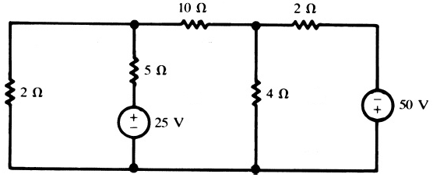
Problems on Mesh Analysis
2. Write the mesh current equations in the circuit shown in Fig.2, and determine the mesh currents using mesh analysis.
Fig. 2

Slide 7
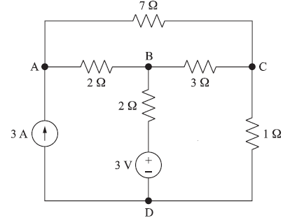
Problems on Mesh Analysis
3. Determine the mesh currents in the circuit shown in Fig.3 using mesh analysis.
Fig. 3

Slide 8
Problems on Mesh Analysis
4. Determine the currents in the bridge circuit shown in Fig.4 using mesh analysis.
Fig. 4

Slide 9
Problems on Mesh Analysis
5. Write the mesh current equations in the circuit shown in Fig.5, and determine the mesh currents using mesh analysis.
Fig. 5

Slide 10
Nodal Analysis
Node analysis is based on Kirchhoff’s current law which states that the algebraic sum of currents meeting at a point is zero.
Every junction where two or more branches meet is regarded as a node. One of the nodes in the network is taken as reference node. If there are n nodes in any network, the number of simultaneous equations to be solved will be (n -1).

Slide 11
Nodal Analysis
Steps to be followed in Node Analysis:
1. If a network has n-nodes, assign a reference node and assign a voltage name for each remaining node.
2. Apply KCL at each node except for the reference node and apply Ohm’s law to the branch currents.
3. Solve the simultaneous equations for the unknown node voltages.
4. Using these voltages, find any branch currents, if required.

Slide 12
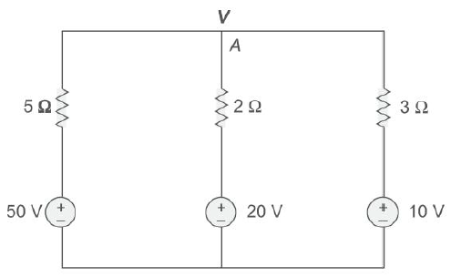
Problems on Nodal Analysis
1. Determine the value of V in the circuit shown in Fig.1 using nodal analysis.
Fig. 1

Slide 13
Problems on Nodal Analysis
2. Using the nodal analysis, find the node voltages in the circuit shown in Fig.2.
Fig. 2

Slide 14
Problems on Nodal Analysis
3. Determine the node voltages at nodes A, B, and C in the circuit shown in Fig. 3 using nodal
analysis.
Fig. 3

Slide 15
Problems on Nodal Analysis
4. Determine the currents in the bridge circuit shown in Fig.4 using nodal analysis.
Fig. 4

Slide 16

SELF-ASSESSMENT QUESTIONS
1. Which are other names of Mesh Analysis?
Mesh current method
Mesh current analysis
Loop current analysis
All the Above
2. Mesh analysis solves _____ type of electrical circuit?
Planar
Non planar
Linear
Non of the Above

Slide 17
SELF-ASSESSMENT QUESTIONS
3. A ____ is any region on an electrical circuit present between two circuit elements.
(a) Point
(b) Node
(c) Breaker
(d) Region
4. Nodal analysis is an application of ____
(a) Kepler’s planetary law
(b) Newton’s law
(c) Kirchhoff’s current law
(d) Faraday’s law

Slide 18
SELF-ASSESSMENT QUESTIONS
5. To obtain all the node voltages, ____ number of equations should be solved in nodal analysis.
(a) n
(b) n+1
(c) 2n
(d) n-1
6. Which law is applied to the super node?
(a) Kepler’s planetary law
(b) Kirchhoff’s Voltage law
(c) Kirchhoff’s current law
(d) Both b & c

Slide 19
REFERENCES FOR FURTHER LEARNING OF THE SESSION
Reference Books:
1. Circuit Theory - Analysis and Synthesis by Abhijit Chakrabarti
2. Electrical Circuit Theory by B. L. Theraja, M. E. Van Valkenburg
3. Fundamentals of Electric Circuits by Charles K. Alexander, Matthew N.O. Sadiku
4. Engineering Circuit Analysis by William H. Hayt, Jack Kemmerly, Steven M. Durbin
Sites and Web links:
1. https://www.youtube.com/watch?v=6A-Qtst3uZY&list=PLgwJf8NK-2e5s5IUh1wLlTioszBrW58bx
2. https://www.tutorialspoint.com/network_theory/network_theory_mesh_analysis.htm
3. https://en.wikipedia.org/wiki/Mesh_analysis

Slide 20
THANK YOU
Team – BEC

